Slide 1
Chapter 6
How to clean the data

Slide 2
Objectives
Applied
Identify the data problems in a DataFrame by using the info(), unique(), nunique(), and value_counts() methods.
Remove duplicate rows from a DataFrame.
Drop unnecessary rows and columns in a DataFrame.
Rename columns so the names are easier to understand.
Find and fix the missing values in a DataFrame.
Find and fix datetime and numeric columns that are imported as object data types.
Replace the invalid values in a column and convert the column to the right data type.
Find and fix outliers.

Slide 3
Objectives (continued)
Knowledge
Describe the ways that you can simplify the data in a DataFrame.
Describe the ways that you can handle missing values.
Describe two common data type problems and how best to fix them.
Describe the ways to handle outliers.
Describe the category data type.

Slide 4
A general plan for cleaning a DataFrame
Identify the problems
Review whatever documentation is available to help you understand the data.
Examine the data after you import it into a DataFrame.
Plan the cleaning that needs to be done.
Simplify the data
Drop duplicate rows.
Drop rows that aren’t needed for the analysis.
Drop columns that aren’t needed for the analysis.
Rename columns so the names are easier to understand.

Slide 5
A general plan for cleaning a DataFrame (cont.)
Fix data problems
Find and fix missing values.
Fix data type problems like dates or numbers that are imported as strings.
Find and fix outliers.
But before you start cleaning...
Be sure that you’ve set the goals for your analysis. That will help you decide what cleaning needs to be done.

Slide 6
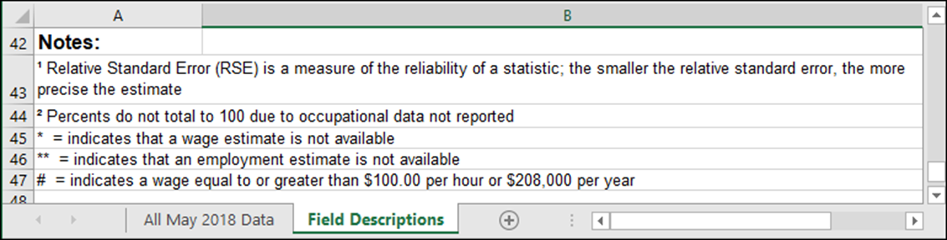
Documentation that identifies some data problems in the Jobs data

Slide 7
Three parameters of the info() method
Parameter | Description
verbose=True | Ensures that the method returns info for all of the columns.
memory_usage='deep' | Ensures that the memory usage information is accurate.
show_counts=True | Ensures that the non-null counts for each column will be displayed.

Slide 8
Partial results for the info() method when run on the Polls data

Slide 9
Partial results for the info() method when run on the Jobs data

Slide 10
What you should be looking for
Object or string variables that look like they should be dates or numbers.
Non-null counts that are lower than the non-null counts of other columns may indicate missing data.
Small numbers of non-nulls or nulls may indicate problems with related columns or rows.

Slide 11
The nunique() and unique() methods
Method | Description
nunique(dropna=False) | Returns the number of unique values in each column.
unique() | Returns the unique values in each column.

Slide 12
Partial results for the nunique() method when run on the Polls data

Slide 13
Partial results for a unique() method that gets the unique values
polls.apply(pd.unique)
=====================================================================
cycle [2016]
branch ['President']
type ['polls-plus' 'now-cast' 'polls-only']
matchup ['Clinton vs. Trump vs. Johnson']
forecastdate ['11/8/16']
state ['U.S.' 'New Mexico' 'Virginia' 'Iowa' 'Wiscon...
startdate ['11/3/2016' '11/1/2016' '11/2/2016' '11/4/201...
enddate ['11/6/2016' '11/7/2016' '11/5/2016' '11/4/201...
pollster ['ABC News/Washington Post' 'Google Consumer S...
samplesize [2220.0 26574.0 2195.0 ... 2422.0 1576.0 950.0]
population ['lv' 'rv' 'a' 'v']
rawpoll_clinton [47.0 38.03 42.0 ... 46.54 21.33 46.46]
rawpoll_trump [43.0 35.69 39.0 ... 40.04 35.05 37.41]
multiversions [nan '*']
poll_id [48630 48847 48922 ... 48838 48248 44180]
question_id [76192 76443 76636 ... 76427 75549 66128]

Slide 14
The value_counts() method
Method | Description
value_counts(params) | Returns the count for each of the unique values in a series.
Parameters of the value_counts() method
Parameter | Description
normalize | If True, returns the counts as a percent of the total rather than the actual counts.
dropna | If True (the default), it ignores null values. Can only be used with Series objects.

Slide 15
How to use the value_counts() method
polls.state.value_counts().head(4)
=================================
U.S. 3318
Florida 444
Pennsylvania 375
North Carolina 375
Name: state, dtype: int64

Slide 16
How to use the normalize parameter
polls.state.value_counts(normalize=True).head(4)
===============================================
U.S. 0.262833
Florida 0.035171
Pennsylvania 0.029705
North Carolina 0.029705
Name: state, dtype: float64

Slide 17
How to use the dropna parameter
polls.multiversions.value_counts(dropna=False)
==============================================
NaN 12588
* 36
Name: multiversions, dtype: int64

Slide 18
How to use the value_counts() method with multiple columns
polls[['state','grade']].value_counts()
=======================================
state grade
U.S. A- 1215
C+ 546
B 162
C- 126
A+ 114
...
Oregon B+ 3
A 3
Kentucky B- 3
Texas B+ 3
Illinois A 3
Length: 321, dtype: int64

Slide 19
How to drop rows based on conditions
By directly accessing a column
polls = polls[polls.type == 'now-cast']
With the query() method
polls = polls.query('type == "now-cast"')

Slide 20
The duplicated() method
Method | Description
duplicated(params) | Identifies duplicated rows.
Parameters of the duplicated() method
Parameter | Description
subset | List of columns to be used for identifying duplicates; otherwise, all columns are used.
keep | If ‘first’ (the default), all duplicates are marked as True except for the first occurrence in each set. If ‘last’, all duplicates are marked as True except for the last occurrence. If False, all duplicates are marked as True.

Slide 21
The drop_duplicates() method
Method | Description
drop_duplicates(params) | Returns the DataFrame with duplicate rows removed.
Parameters of the drop_duplicates() method
Parameter | Description
subset | Same as for the duplicated() method.
keep | Same as for the duplicated() method except that the duplicate rows are dropped, not marked.
inplace | True makes the changes directly to the DataFrame; False (the default) returns a copy of the DataFrame with the duplicates dropped.

Slide 22
How to drop duplicate rows
How to find duplicate rows
fires[fires.duplicated(keep=False)]
How to drop duplicate rows
fires.drop_duplicates(keep='first', inplace=True)

Slide 23
The drop() method
Method | Description
drop(params) | Drops the columns that are specified by the columns parameter.
Parameters of the drop() method
Parameter | Description
columns | List of columns to be dropped.
errors | What to do if a specified column doesn’t exist: ‘ignore’ (the default) or ‘raise’.
inplace | True makes the changes directly to the DataFrame.

Slide 24
How the nunique() method helps you identify columns that you may want to drop

Slide 25
How to use the drop() method to drop columns
With inplace=False
polls = polls.drop(columns=['cycle','forecastdate'])
With inplace=True
polls.drop(columns=['cycle','forecastdate'], errors='raise',
inplace=True)

Slide 26
The rename() method for columns
Method | Description
rename(params) | Renames the columns of a DataFrame.
Parameters of the rename() method
Parameter | Description
columns | A dictionary that contains the columns to be renamed and the new names for those columns.
inplace | Whether to make changes directly to the DataFrame. The default is False.

Slide 27
How to rename columns with the rename() method
How to rename columns with an embedded dictionary
polls = polls.rename(columns={
'rawpoll_clinton':'clinton_pct',
'rawpoll_trump':'trump_pct'})
How to rename columns with a separate dictionary and inplace set to True
polls_names_dict = {'rawpoll_clinton':'clinton_pct',
'rawpoll_trump':'trump_pct'}
polls.rename(columns = polls_names_dict, inplace = True)

Slide 28
How to rename columns with the Python replace() method
How to use a simple expression with the replace() method
polls.columns = polls.columns.str.replace('_pct','')
How to use regular expressions with the replace() method
jobs.columns = jobs.columns \
.str.replace('^a_','annual_', regex=True) \
.str.replace('^h_','hourly_', regex=True) \
.str.replace('_pct','_percent')

Slide 29
The isnull(), notnull(), and any() methods
Method | Description
isnull() | Returns a Boolean same-sized object indicating whether the values are NA.
notnull() | Returns a Boolean same-sized object indicating whether the values are not NA.
any(axis=1) | Returns True if any column in a row contains a missing value.

Slide 30
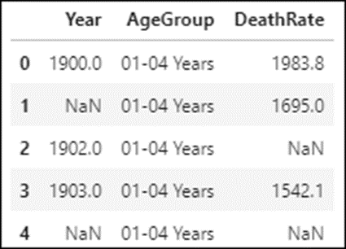
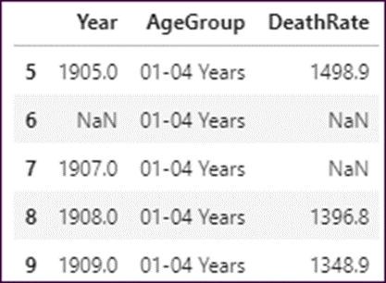
A ten-row DataFrame named mortality_data that has some missing values

Slide 31
How to display the count of the missing values
missing_count = mortality_data.shape[0] – mortality_data.count()
print(missing_count)
================================================================
Year 3
AgeGroup 0
DeathRate 4

Slide 32
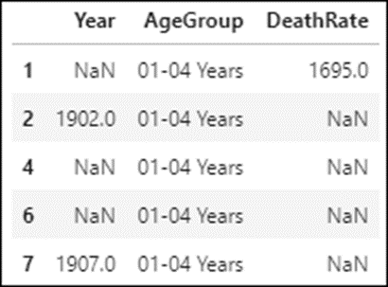
How to display all rows that contain NA values
mortality_data[mortality_data.isnull().any(axis=1)]

Slide 33
How to display all rows with NA values in the DeathRate column
mortality_data[mortality_data.DeathRate.isnull()]
How to display all rows that don’t have NA values in the DeathRate column
mortality_data[mortality_data.DeathRate.notnull()]

Slide 34
The dropna() method
Method | Description
dropna(params) | Drops the rows that are specified by the parameters.
Parameters of the dropna() method
Parameter | Description
subset | A list of the columns that the drop should be based on.
how | If ‘any’ (the default), a row is dropped if any column contains an NA value. If ‘all’, a row is dropped only if all columns contain NA values.
thresh | An integer that specifies how many columns need to contain NA values before the row is dropped.
inplace | Whether to make changes directly to the DataFrame. The default is False.

Slide 35
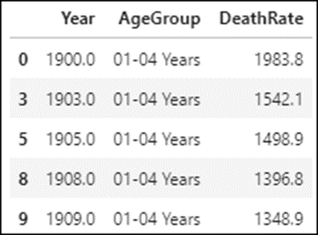
How to drop all rows that contain an NA value
mortality_data = mortality_data.dropna()

Slide 36
How to drop only the rows that have two or more NA values
mortality_data.dropna(thresh=2, inplace=True)
How to drop only the rows that have NAs in the DeathRate column
mortality_data.dropna(subset=['DeathRate'], inplace=True)

Slide 37
The fillna() method
Method | Description
fillna(params) | Fills the NA values in a DataFrame.
Parameters of the fillna() method
Parameter | Description
value | The value that will replace the NAs or a dict with the column name and value for each column that will be filled.
method | The method to use for replacing the NAs: ‘pad’ or ‘ffill’ to forward fill and ‘backfill’ or ‘bfill’ to backward fill.
limit | The maximum number of consecutive NAs in a column to fill.
inplace | Whether to make changes directly to the DataFrame. The default is False.

Slide 38
How to replace the NAs in a column with the mean value of the column
mortality_data.DeathRate.fillna(
value=mortality_data.DeathRate.mean(), inplace=True)

Slide 39
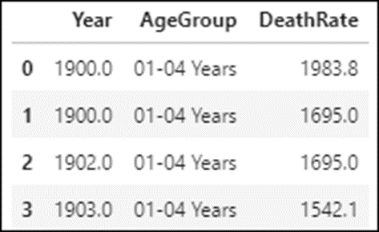
How to forward fill NA values with a limit of 2 consecutive fills
mortality_data.fillna(method = 'ffill', limit=2, inplace=True)
mortality_data.head(4)

Slide 40
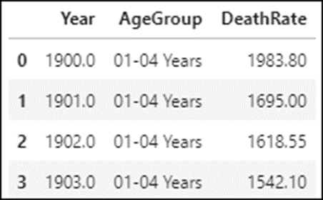
The interpolate() method
Method | Description
interpolate() | Uses linear interpolation to fill the missing values in a DataFrame.
How to fill NA values with linear interpolation
mortality_data = mortality_data.interpolate()
mortality_data.head(4)

Slide 41
The data types that Pandas applies to imported columns
Data type | When the column contains…
int64 | Only integers or NAs
float64 | Only floating-point numbers or NAs
bool | Only Boolean values (True or False)
object | Strings or data that doesn’t import as another data type

Slide 42
The select_dtypes() method of a DataFrame
Method | Description
select_dtypes(type) | Selects all columns with the specified data type.

Slide 43
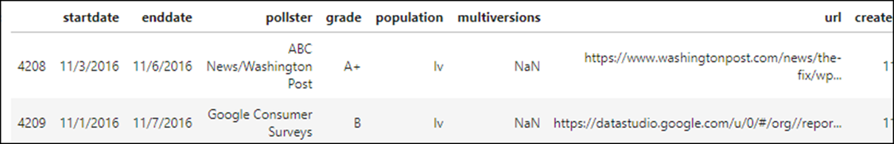
Polls data: Dates stored as objects
polls.select_dtypes('object').head(2)

Slide 44
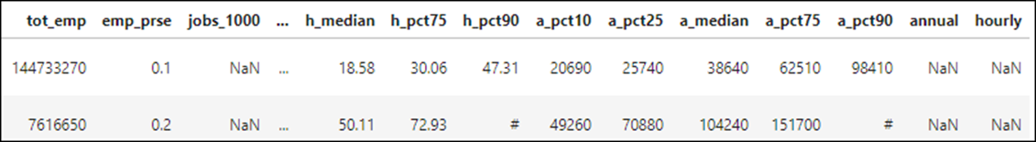
Jobs data: Numeric and Boolean values stored as objects
jobs.select_dtypes('object').head(2)

Slide 45
How Pandas applies data types to imported columns
If a column consists entirely of numbers and NA values, Pandas imports the column with either the int64 or float64 data type.
If a column consists entirely of True and False values, Pandas imports the column with the bool data type.
Pandas imports all other columns with the object data type.

Slide 46
The Pandas to_datetime() method
Method | Description
to_datetime() | Converts columns that contain date strings to datetime objects.

Slide 47
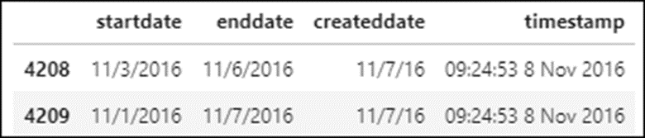
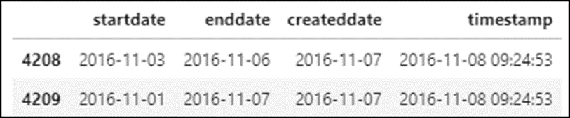
Four of the date columns in the polls DataFrame
date_cols = ['startdate','enddate','createddate','timestamp']
How to convert dates to datetime objects with inferred formatting
polls[date_cols].apply(pd.to_datetime)

Slide 48
A few of the formatting codes for the Python strftime() method
Code | Description
%m | The month of the year as an integer
%d | The day of the month as an integer
%y | A 2-digit year
%Y | A 4-digit year

Slide 49
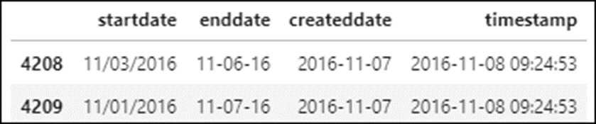
How to use the Python strftime() method to format dates as strings
polls['startdate'] = polls.startdate.dt.strftime("%m/%d/%Y")
polls['enddate'] = polls.enddate.dt.strftime("%m-%d-%y")

Slide 50
The to_numeric() method
Method | Description
to_numeric(columns,errors) | Tries to convert the data in a column to a numeric type.
Three options for the errors parameter
Option | Description
raise | Raises an error if there is any non-numeric data in a column except for NA values. This is the default.
ignore | Ignores the error and doesn’t change the column at all.
coerce | Converts non-numeric values to NaN.

Slide 51
How to convert columns with valid numeric strings to numeric data types
pd.to_numeric(jobs.tot_emp)

Slide 52
How to coerce columns with invalid strings into numeric data types
The original data
jobs.tot_emp.tail(3)
=============================================================
403892 170
403893 130
403894 **
Name: tot_emp, dtype: object
Without an errors parameter, an error is raised
pd.to_numeric(jobs.tot_emp)
==============================================================
ValueError: Unable to parse string "**" at position 1906
With the errors parameter set to coerce
pd.to_numeric(jobs.tot_emp, errors='coerce').tail(3)
==============================================================
403892 170.0
403893 130.0
403894 NaN
Name: tot_emp, dtype: float64

Slide 53
The astype() method for converting data types
Method | Description
astype(type,errors) | Tries to convert the data to the specified data type. Errors are raised by default, but they can be ignored by setting the errors parameter to ‘ignore’.
How to convert object columns to the category data type
fires.state = fires.state.astype('category')

Slide 54
The remove_unused_categories() method
Method | Description
remove_unused_categories() | Removes unused categories from a table.

Slide 55
How to drop rows for specific categories
Drop the rows for the categories that aren’t in the query
filteredStatCounts = statCounts.query(
'wrkstat in ["working fulltime","working parttime","retired"]')
filteredStatCounts.wrkstat.value_counts()
=====================================================================
retired 31892
working parttime 9121
working fulltime 6719
other 0
keeping house 0
school 0
unempl, laid off 0
temp not working 0
Name: wrkstat, dtype: int64

Slide 56
How to drop rows for specific categories (cont.)
Drop the unused categories
filteredStatCounts['wrkstat'] = \
filteredStatCounts.wrkstat.cat.remove_unused_categories()
filteredStatCounts.wrkstat.value_counts()
=============================================================
retired 31892
working parttime 9121
working fulltime 6719
Name: wrkstat, dtype: int64

Slide 57
The Pandas replace() method
Method | Description
replace(to_replace,value, inplace) | Replaces the strings in the to_replace parameter with the strings in the value parameter or replaces the old values in a dictionary with the new values.

Slide 58
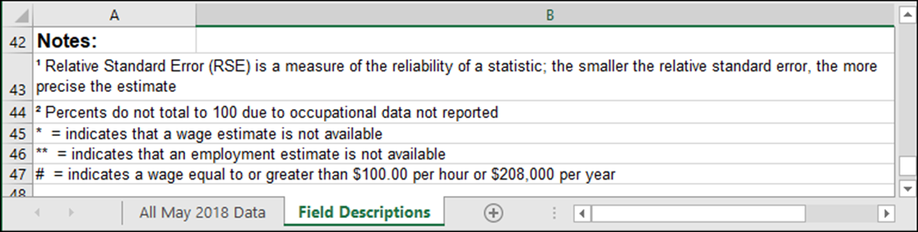
Documentation that identifies some data problems in the Jobs data

Slide 59
How to replace * or ** values in a single column with NaN
import numpy as np
jobs.tot_emp.replace(to_replace=['*','**'], value=[np.nan,np.nan], inplace=True)
How to use a dictionary to replace * or ** values in a single column with NaN
jobs.tot_emp.replace({'*':np.nan, '**':np.nan}, inplace=True)
How to replace # values with a numeric value
jobs.hourly_median = jobs.hourly_median.replace(
to_replace='#', value=100)
How to replace NaN values with False in what should be a Boolean column
jobs.hourly.replace(to_replace=np.nan, value=False, inplace=True)

Slide 60
Some useful parameters of the read_csv() method
Parameter | Description
header | The row and column names where the import should start.
usecols | The columns to be imported.
nrows | The number of rows to import.
parse_dates | The columns that the to_datetime() method should try to convert.
na_values | The strings that should be treated as NAs.
true_values | The values that the dataset uses for True.
false_values | The values that the dataset uses for False.

Slide 61
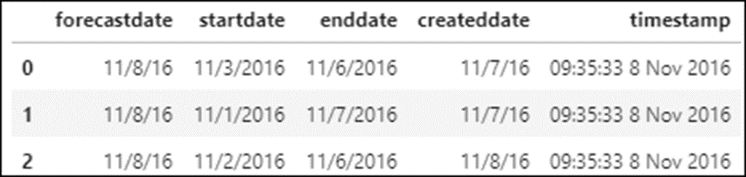
How to parse object columns that contain dates and times
The date columns to be parsed
date_cols = ['forecastdate','startdate','enddate','createddate','timestamp']
The url for the file
polls_url = \
'http://projects.fivethirtyeight.com/.../president_general_polls_2016.csv'
An import with no changes
polls = pd.read_csv(polls_url)
polls[date_cols].head(3)

Slide 62
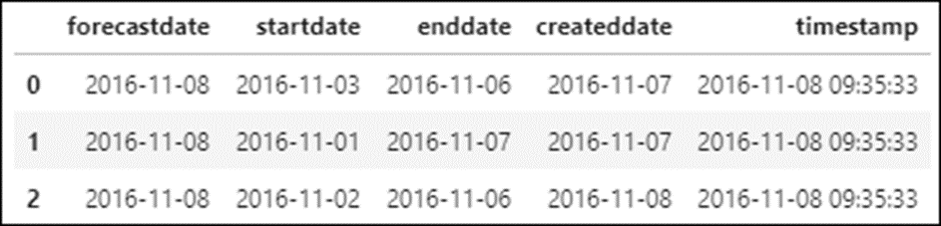
How to parse object columns that contain dates and times (continued)
An import with parsed dates
polls_new = pd.read_csv(polls_url, parse_dates=date_cols)
polls_new[date_cols].head(3)

Slide 63
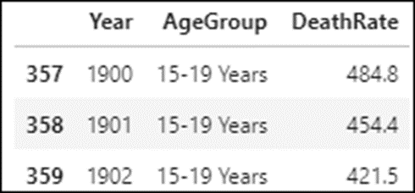
The mortality data for the 15-19 age group
mortality_group = \
mortality_data.query('AgeGroup == "15-19 Years"')
mortality_group.head(3)

Slide 64
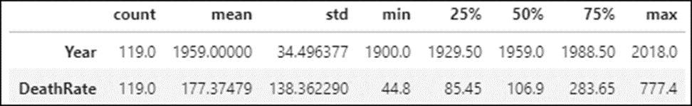
How to use the describe() method to find outliers
mortality_group.describe().T

Slide 65
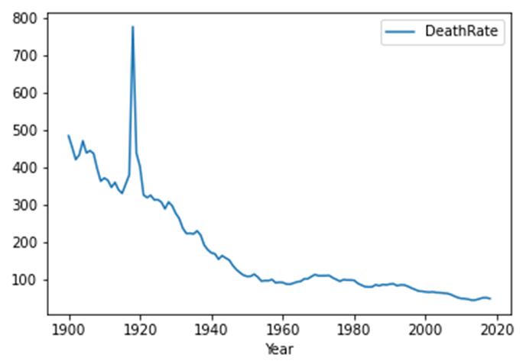
How to use the plot() method to find outliers
mortality_group.plot(x='Year', y='DeathRate')

Slide 66
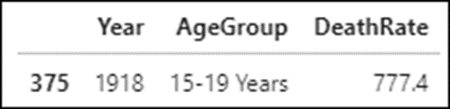
How to review the outliers in the DeathRate column
mortality_group.query('DeathRate > 500')

Slide 67
Three ways to handle outliers that are valid
Drop the outliers.
Cap the outliers at values that won’t skew the results.
Assign new values to the outliers like the mean of the column or a linear interpolation.

Slide 68
How to drop the rows for the outliers
mortality_group = mortality_group.query('DeathRate <= 500')
How to cap the values of the outliers at 450
mortality_group.loc[mortality_group.DeathRate > 500,'DeathRate'] = 450

Slide 69
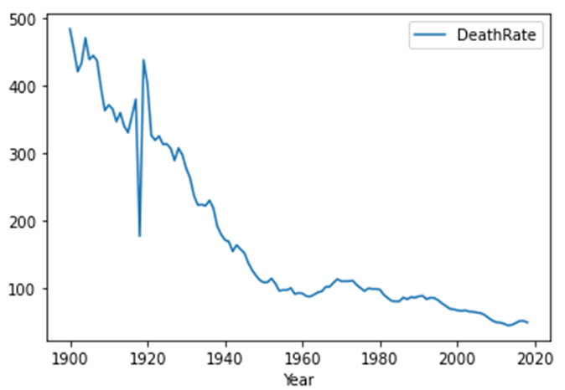
How to assign the mean of the column to the outliers
mortality_group.loc[mortality_group.DeathRate > 500,'DeathRate'] \
= mortality_group.DeathRate.mean()
mortality_group.plot(x='Year', y='DeathRate')

Slide 70
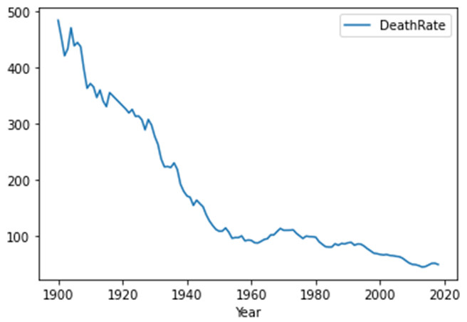
How to use interpolation to smooth the outliers
mortality_group.loc[mortality_group.Year.isin([1917,1918,1919,1920]),
'DeathRate'] = None
mortality_group = mortality_group.interpolate()
mortality_group.plot(x='Year', y='DeathRate')

